Slide 1
Loan Case Study
Data Spark:
Vinay Dharra
Vijay Krishnan
Shubham Pali
VENKATA NITHEESH IMMADI

Slide 2
<Abstract>
Based on detailed analysis we performed on dataset provided, we have concluded following results
NV, NM , SD and NJ areas have high rates of Charged Off Loans. Hence it is prudent to discover more why default is happening in these areas and company must take care of this in future disbursals
The small business loans, renewable energy loans and educational loans had the higher risk of loan defaults
The loan applicants belonging to grades E to F defaulted on loans
The applicants belonging to the annual income group which is less than 25000 USD defaulted on loans.
Most of the applicant's loan interest rates fall between 7% to 10% but the risk is also high due to higher charged off numbers.
The company is not advised to give loans to any applicants who have shorter duration of service (less than a year) as part of previous employment record. Maybe the applicant has joined a new company or in probation carries a higher risk of loan defaults
The probability of higher defaults lies in the 15000-20000 (funded amount) category. Hence more analysis can be done on for what purpose this amount is used and accordingly take the action as needed

Slide 3
<Problem solving methodology>
Start
Data Cleaning:
Check null percentage and removing unwanted column & check for distinct values in column
Univariant Analysis on continuous variable : loan_amnt, int_rate, annual_inc & on categorical variable : loan_status, purpose etc to get meaningful insights on data.
Derived Matrix :Some New Columns are derived for analysis like,loan_income_ratio,issue_month,issue_year etc
Stop
Conclusion based on graphs plot and observation .
Bivariant Analysis : find charge off probability by state, purpose ,annual income, grades, employee experience, interest rate.
Correlation Matrix : Draw heatmap to find correlation between variables.

Slide 4
<Analysis>
Business Understanding :
A consumer finance company which specialises in lending various types of loans to urban customers. When the company receives a loan application, the company has to make a decision for loan approval based on the applicant’s profile. Two types of risks are associated with the bank’s decision:
• If the applicant is likely to repay the loan, then not approving the loan results in a loss of business to the company
• If the applicant is not likely to repay the loan, i.e. he/she is likely to default, then approving the loan may lead to a financial loss for the company
Data Understanding:
Dataset contains the information about past loan applicants and whether they ‘defaulted’ or not.
Univariant Analysis:
On univariant analysis on continuous and categorical variable we have observed following results.
distribution of the loan amounts is in the range of 5000 - 2000 USD.
distribution of the Interest Rate for the loans is around 10% - 15%
majority of the applications applying for the loan earns around 40000 to 90000 annually.
around 5210 applicants or 14% are charged off when they defaulted on the loan
the majority of the loans has been taken was for debt consolidation
It is observed that with respect to the loan status fully paid, around 41% has rented their homes and 35% percent has mortgaged their homes
The desired loan tenure is 36 months where the loans are getting fully paid off

Slide 5
<Analysis>
Bivariate/Multivariate Analysis:
On Multivariant analysis we have observed following results,
It is observed that NV, NM , SD and NJ areas have high rates of Charged Off Loans. Hence it is prudent to discover more why default is happening in these areas and company must take care of this in future disbursals
The small business loans, renewable energy loans and educational loans had the higher risk of loan defaults
The loan applicants belonging to grades E to F defaulted on loans
The applicants belonging to the annual income group which is less than 25000 USD defaulted on loans.
Most of the applicant's loan interest rates fall between 7% to 10% but the risk is also high due to higher charged off numbers.
The company is not advised to give loans to any applicants who have shorter duration of service (less than a year) as part of previous employment record. Maybe the applicant has joined a new company or in probation carries a higher risk of loan defaults
The probability of higher defaults lies in the 15000-20000 (funded amount) category. Hence more analysis can be done on for what purpose this amount is used and accordingly take the action as needed

Slide 6
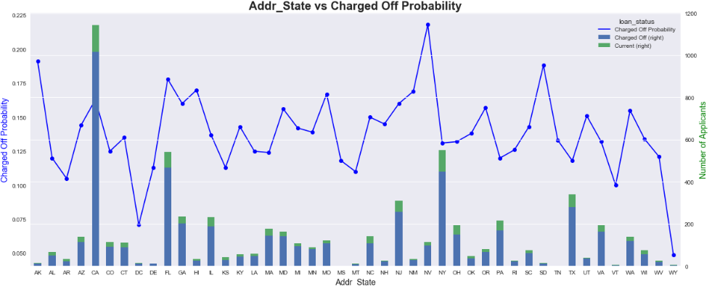
Charged Off Probability by State

Slide 7
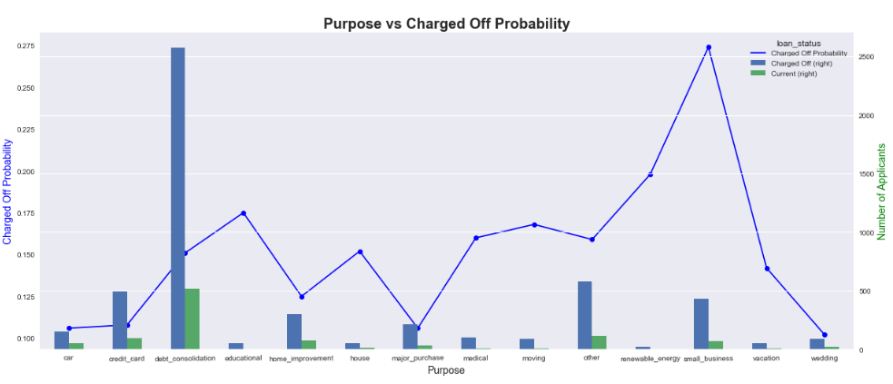
Charged Off Probability by Purpose

Slide 8
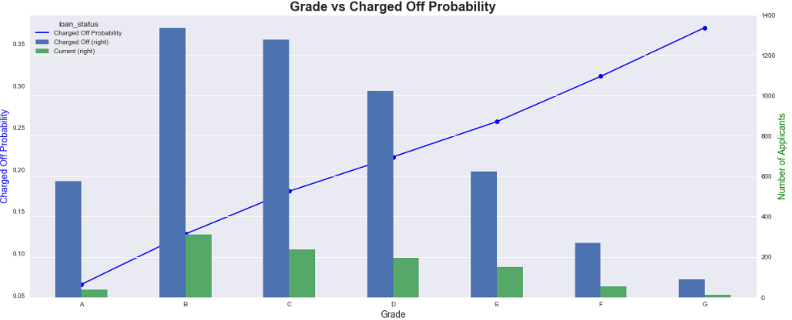
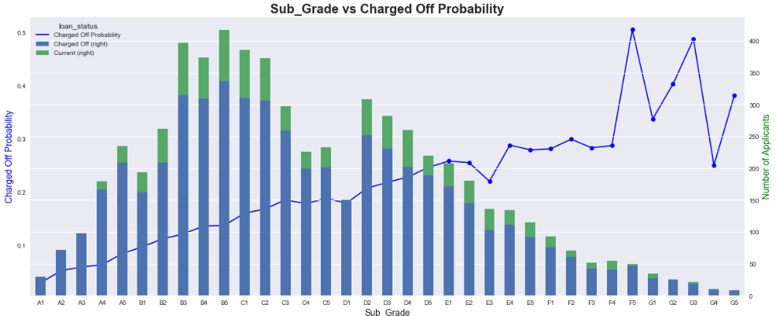
Charged Off Probability by Grade

Slide 9
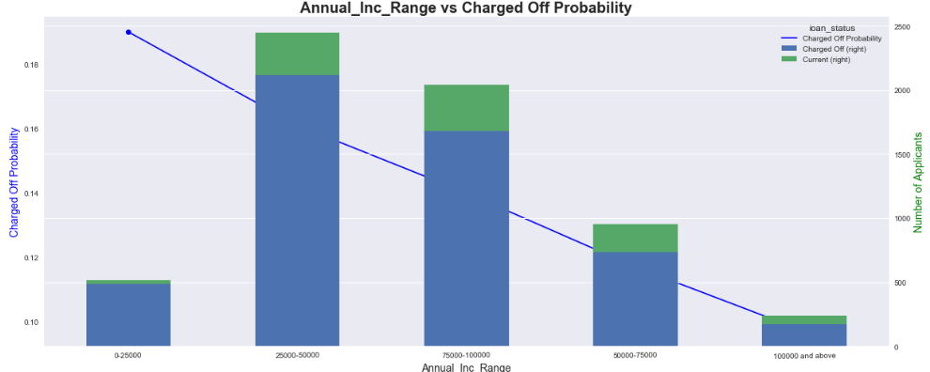
Charged Off Probability by Annual Income

Slide 10
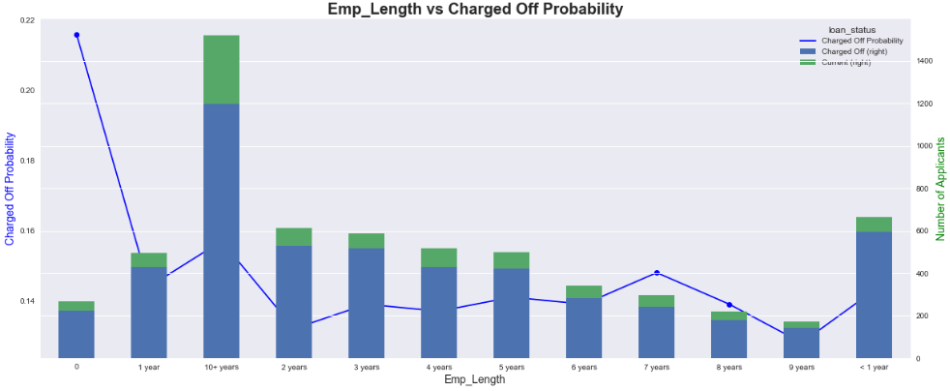
Charged Off Probability by Employment Service

Slide 11
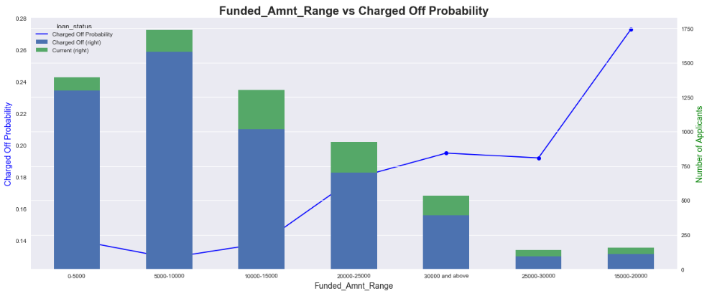
Charged Off Probability by Loan Funded Amount

Slide 12
<Conclusions>
Following driving factors are behind the loan defaults :
Location or District or State where the Loan Applicant belongs to.
Purpose of the Loan
Annual Income of the Loan Applicant
Loan Grade to which the Applicant is categorized
Employee Term of Service i.e the Applicant Employment Record
Loan Funded Amount

